Slide 1
Building Models
From: Miller 2015

Slide 2
What is a Model?
A model is a representation of things, a rendering or description of reality.
In data science, a model is an attempt to relate one set of variables to another.
Models are, by nature, limited and imprecise, but useful.

Slide 3
Developing Models
Models, as opposed to the real world, are used for experimentation with changes
This is because they
Require Less Time
Are Less Expensive
Involve Less Risk
The more closely the model represents the real situation, the accurate the conclusions and predictions will be

Slide 4
Correlation

Slide 5
Correlation
Correlation is a statistical measure of the strength of a linear relationship between two variables
Correlation is denoted by the letter r
Correlation is bounded between 1 and -1
r= 1 (perfect positive relationship)
r= -1 (perfect negative relationship)
r= 0 (no relationship)

Slide 6
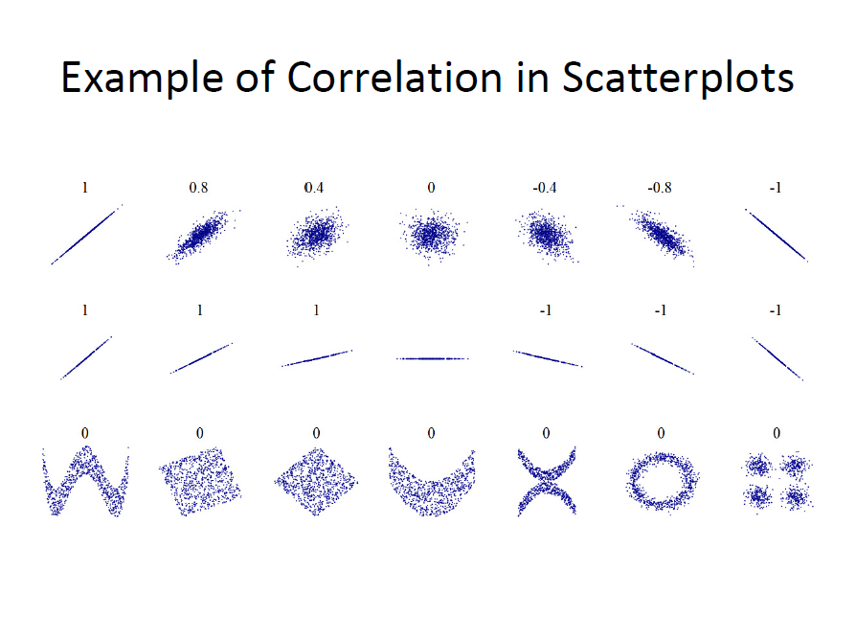

Slide 7
Correlation vs Causation
Correlation implies there is a “relationship”
01
Causation implies one variable directly influences another variable
02
Correlation does NOT imply causation
03
Correlation does NOT imply causation
04

Slide 8
Examples
Causation
Food Consumption and Weight
Rainfall and Crop Production
Correlation
Height and Shoe Size
Ice Cream Sales and Drowning
Ambiguous
Education and Earnings
Marketing Expenditures and Sales Revenue

Slide 9
Spurious Correlation

Slide 10
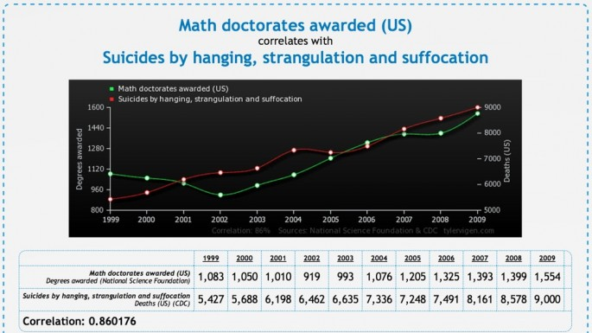

Slide 11
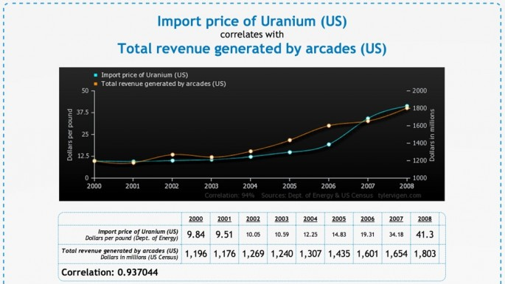

Slide 12
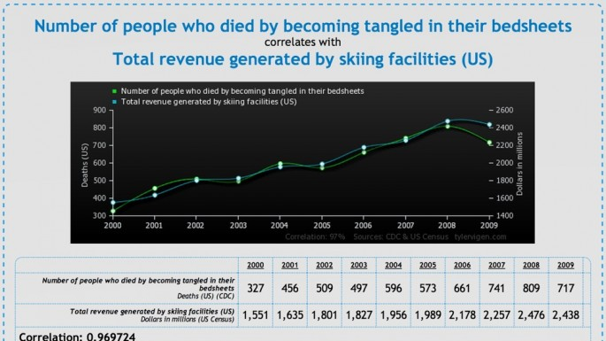

Slide 13
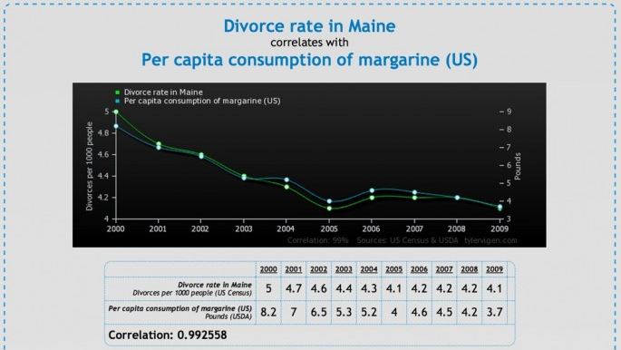

Slide 14
Regression Modeling
Regression modeling allows us to model the world, and predict responses to both qualitative and quantitative variables.

